Slide 1

PROJECT
on
Cloud Based IoT Home with Hindi Voice Commands using Google Assistant and ESP32
(CSE V Semester Mini project PCS-504)
2020-2021

Slide 2
ABOUT PROJECT
This is a Cloud Based IoT Hindi Voice Commands using Google Assistant and ESP32 project. In this project, we will be using some IoT devices which will connect to our phone’s Google Assistant application.
Here we will be connecting and controlling our ESP32 Wi-Fi based module from our mobile phone’s Google Assistant application. As we all know that Hindi is the national language of India and so most of the people speaks in Hindi. This project is designed so that your google assistant will take voice commands in Hindi and perform actions on ESP32. After that it will perform actions based on your voice commands.
This project is helpful and amazing for those who want to make a voice operated home automation for their parents or grandparents who are not able to speak English and comfortable with Hindi language. We can also make this project with other regional language.
To make this project work, I have used Adafruit IO and IFTTT. I have added up all these required things to work.

Slide 3
Project Requirement
2.1.1 Software Requirement
Google Assistant
Google Assistant is an artificial intelligence–powered virtual assistant developed by Google that is primarily available on mobile and smart home devices. Unlike the company's previous virtual assistant, Google Now, the Google Assistant can engage in two-way conversations.
Adafruit IO
Adafruit.io is a cloud service - that just means we run it for you and you don't have to manage it. You can connect to it over the Internet. It's meant primarily for storing and then retrieving data but it can do a lot more than just that.
IFTTT
IFTTT derives its name from the programming conditional statement “if this, then that.” What the company provides is a software platform that connects apps, devices and services from different developers in order to trigger one or more automations involving those apps, devices and services.

Slide 4
Hardware Requirements
ESP32
It is a series of low-cost, low-power system on a chip microcontrollers with integrated Wi-Fi and dual mode Bluetooth.
USB Type C cable to program ESP32 from a laptop or PC
USB Tyle C cable is mostly used in Android phones.
Relay Module
Relay is a switching module. In a relay, we can control switching AC or DC appliances digitally by providing input to relay input pins. Here we have used a 2-channel relay operating on a 5 volts battery.

Slide 5
METHODOLOGY
The methodology of this project design includes implementation of the proposed method. There are some basic steps involving in the Methodology of the product. The first major step is setting up the Adafruit IO. Adafruit IO is a website used to create virtual switches which will be turned ON or OFF depending on the commands given to the Google assistant and the second step is connecting the ESP32 and the last step is connecting to Google assistant through IFTTT. IFTTT is also a website used to create simple chain of conditional statements for like if else statements. By following these three steps, the implementation of the proposed system is going to be done.

Slide 6
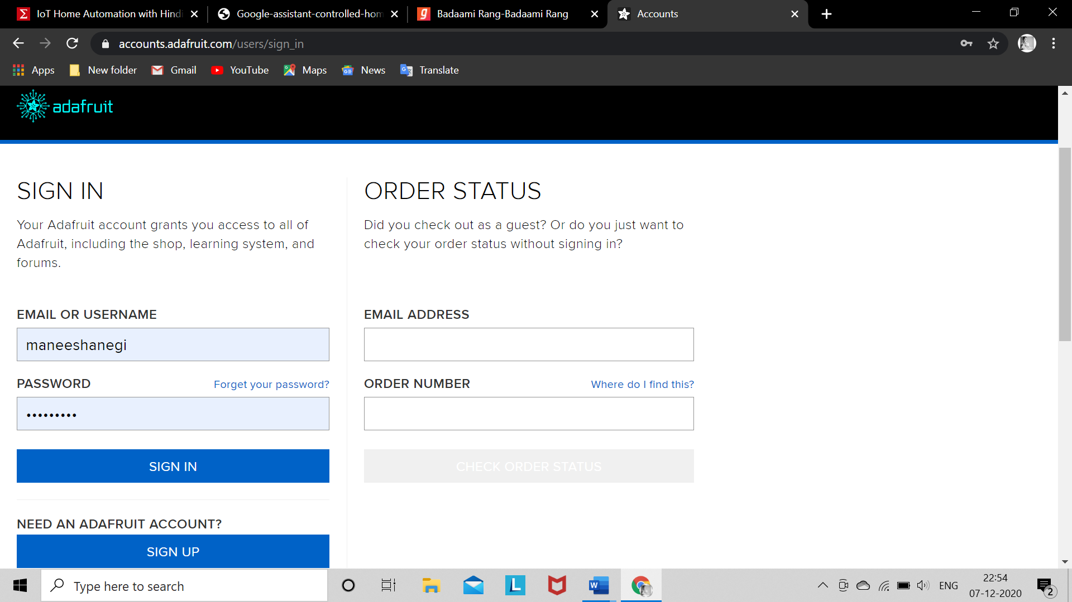
ADAFRUIT IO
First, create account at www.Adafruit.io
Fig 3.1 Adafruit IO Sign in page

